Slide 1
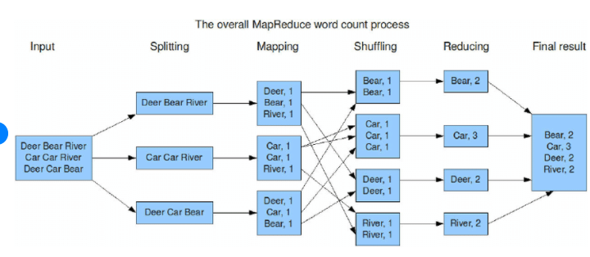
MapReduce
CHAPTER 1: ADVANCE MAP-REDUCE

Slide 2
Before MapReduce…
Large scale data processing was difficult!
Managing hundreds or thousands of processors
Managing parallelization and distribution
I/O Scheduling
Status and monitoring
Fault/crash tolerance
MapReduce provides all of these, easily!

Slide 3
MapReduce Overview
MapReduce is a programming model for processing large data sets with a parallel, distributed algorithm on a cluster
How does it solve our previously mentioned problems?
MapReduce is highly scalable and can be used across many computers.
Many small machines can be used to process jobs that normally could not be processed by a large machine.

Slide 4
How MapReduce works?
MapReduce is a method for distributing a task across multiple nodes
Each node processes data stored on that node
Where possible
Consists of two phases:
Map
Reduce

Slide 5
Features of MapReduce
Automatic parallelization and distribution
Fault‐tolerance
Status and monitoring tools
A clean abstraction for programmers
MapReduce programs are usually written in Java
Can be written in any language using Hadoop Streaming (see later)
All of Hadoop is written in Java
MapReduce abstracts all the ‘housekeeping’ away from the developer
Developer can concentrate simply on working the Map and Reduce functions

Slide 6
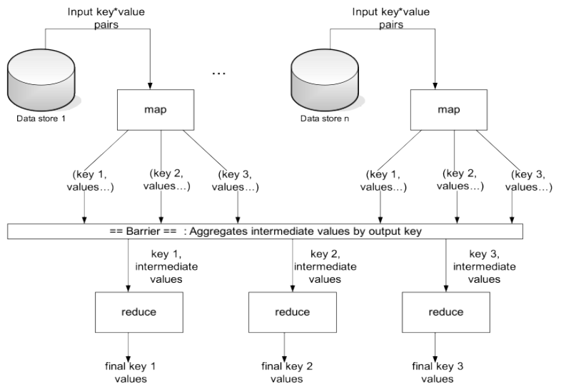
A Bigger Picture

Slide 7
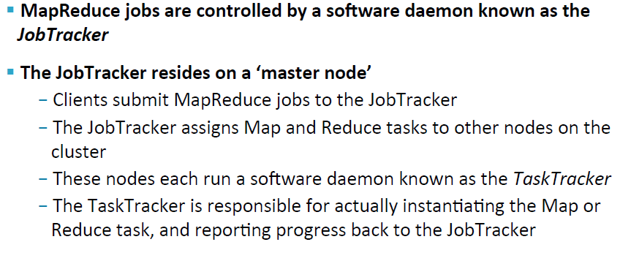
MapReduce: The JobTracker

Slide 8
Basic Cluster Configuration

Slide 9
MapReduce: Terminology

Slide 10
MapReduce : The Mapper

Slide 11
MapReduce : The Mapper

Slide 12
MapReduce : The Reducer

Slide 13
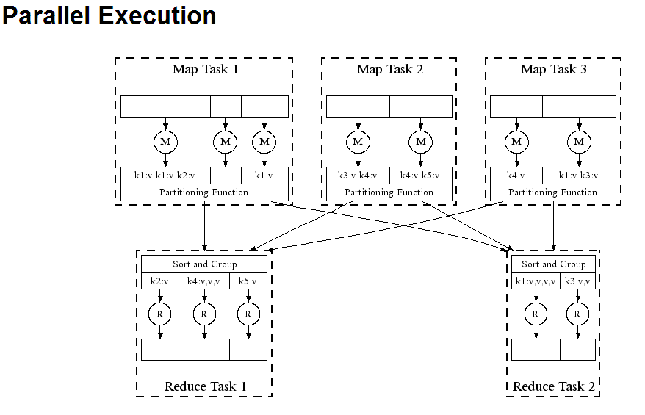
Diagram

Slide 14
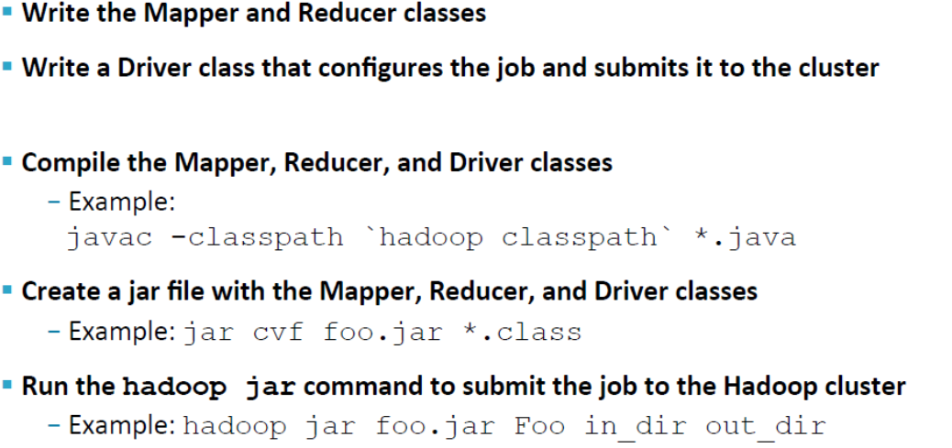
Creating and Running a MapReduce Job

Slide 15
The MapReduce Flow: The Mapper

Slide 16
The MapReduce Flow: Shuffle and Sort

Slide 17
The MapReduce Flow: The Reducer

Slide 18
Our MapReduce Program: WordCount
This consists of three portions
The driver Code – Code that runs on the client to configure and submit the job
The Mapper
The Reducer

Slide 19
Some Standard Input Formats

Slide 20
Keys and Values
Keys and Values Are Objects
Values are objects that implements Writable
Keys are objects that implements WritableComparable
Hadoop defines its own ‘box classes’ for strings, integers etc
IntWritable
LongWritables
FloatWritables
Text
…

Slide 21
Sorting & Searching

Slide 22
Sorting
MapReduce is very well suited to sorting large data sets
Recall: keys are passed to the Reducer in sorted order
Assuming the file to be sorted contains lines with a single value:
Mapper is merely the identity function for the value
(k, v) -> (v, _)
Reducer is the identity function
(k, _) -> (k, '')

Slide 23
Searching
Assume the input is a set of files containing lines of text
Assume the Mapper has been passed the pattern for which to search as a special parameter
We saw how to pass parameters to your Mapper
Algorithm:
Mapper compares the line against the pattern
If the pattern matches, Mapper outputs (line, _)
Or (filename+line, _), or …
If the pattern does not match, Mapper outputs nothing
Reducer is the Identity Reducer
Just outputs each intermediate key

Slide 24
Counters
You can instrument your Hadoop job with counters to profile its overall operation. Your program defines various counters and increments their counts in response to specific events. Hadoop automatically sums the same counter from all tasks (of the same job) so that it reflects the profile of the overall job. It displays the value of your counters in the JobTracker’s Web UI along with Hadoop’s internal counters. The canonical application of counters is for tracking different input record types, particularly for tracking “bad” records.
We use counters through the Reporter.incrCounter() method. The Reporter object is passed to the map() and reduce() methods. You call incrCounter() with the name of the counter and the amount to increment. You use uniquely named counters for each different event. When you call incrCounter() with a new counter name, that counter is initialized and takes on the increment value

Slide 25
Joins

Slide 26

Joins
When processing large data sets the need for joining data by a common key can be very useful, if not essential.
We will be covering 2 types of joins, Reduce-Side joins, Map-Side joins
SELECT Employees.Name, Employees.Age, Department.Name FROM Employees INNER JOIN Department ON Employees.Dept_Id=Department.Dept_Id

Slide 27
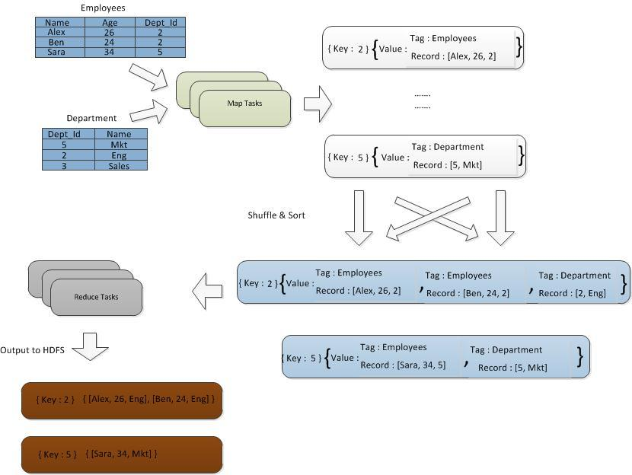
Reduce Side Join

Slide 28
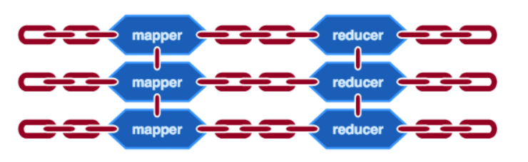
Chaining in Map reduce
When handling advanced data processing, you’ll often find that you can’t program the process into a single MapReduce job.
Hadoop supports chaining MapReduce programs together to form a bigger job. You’ll also find that advanced data processing often involves more than one data set.

Slide 29
Chaining in Map reduce
You’ve been doing data processing tasks which a single MapReduce job can accomplish.
As you get more comfortable writing MapReduce programs and take on more ambitious data processing tasks, you’ll find that many complex tasks need to be broken down into simpler subtasks, each accomplished by an individual MapReduce job.
For example, from the citation data set you may be interested in finding the ten mostcited patents. A sequence of two MapReduce jobs can do this. The first one creates the “inverted” citation data set and counts the number of citations for each patent, and the second job finds the top ten in that “inverted” data.

Slide 30
Chaining MapReduce jobs in a sequence
Though you can execute the two jobs manually one after the other, it’s more convenient to automate the execution sequence. You can chain MapReduce jobs to run sequentially, with the output of one MapReduce job being the input to the next.
Chaining MapReduce jobs is analogous to Unix pipes.
mapreduce-1 | mapreduce-2 | mapreduce-3 | ...

Slide 31
Chaining MapReduce jobs in a sequence
Chaining MapReduce jobs sequentially is quite straightforward. Recall that a driver sets up a JobConf object with the configuration parameters for a MapReduce job and passes the JobConf object to JobClient.runJob() to start the job.
As Job- Client.runJob() blocks until the end of a job, chaining MapReduce jobs involves calling the driver of one MapReduce job after another. The driver at each job will have to create a new JobConf object and set its input path to be the output path of the previous job. You can delete the intermediate data generated at each step of the chain at the end.

Slide 32
Chaining MapReduce jobs with complex dependency
Sometimes the subtasks of a complex data processing task don’t run sequentially, and their MapReduce jobs are therefore not chained in a linear fashion.
For example, mapreduce1 may process one data set while mapreduce2 independently processes another data set. The third job, mapreduce3, performs an inner join of the first two jobs’ output.
It’s dependent on the other two and can execute only after both mapreduce1 and mapreduce2 are completed. But mapreduce1 and mapreduce2 aren’t dependent on each other.
Hadoop has a mechanism to simplify the management of such (nonlinear) job dependencies via the Job and JobControl classes.

Slide 33
Chaining MapReduce jobs with complex dependency
A Job object is a representation of a MapReduce job. You instantiate a Job object by passing a JobConf object to its constructor. In addition to holding job configuration information, Job also holds dependency information, specified through the addDependingJob() method.
For Example: Job objects x and y,
x.addDependingJob(y)
means x will not start until y has finished. Whereas Job objects store the configuration and dependency information, JobControl objects do the managing and monitoring of the job execution. You can add jobs to a JobControl object via the addJob() method. After adding all the jobs and dependencies, call JobControl’s run() method to spawn a thread to submit and monitor jobs for execution. JobControl has methods like all-Finished() and getFailedJobs() to track the execution of various jobs within the batch.

Slide 34
Chaining preprocessing and postprocessing steps
A lot of data processing tasks involve record-oriented preprocessing and postprocessing.
For example, in processing documents for information retrieval , you may have one step to remove stop words (words like a, the, and is that occur frequently but aren’t too meaningful), and another step for stemming (converting different forms of a word into the same form, such as finishing and finished into finish.)
You can write a separate MapReduce job for each of these pre- and postprocessing steps and chain them together, using IdentityReducer (or no reducer at all) for these steps. This approach is inefficient as each step in the chain takes up I/O and storage to process the intermediate results.

Slide 35
Chaining preprocessing and postprocessing steps
Another approach is for you to write your mapper such that it calls all the preprocessing steps beforehand and the reducer to call all the postprocessing steps afterward.
This forces you to architect the pre- and postprocessing steps in a modular and composable manner. Hadoop introduced the ChainMapper and the ChainReducer classes in version 0.19.0 to simplify the composition of pre- and postprocessing.
The job runs multiple mappers in sequence to preprocess the data, and after running reduce it can optionally run multiple mappers in sequence to postprocess the data.
The beauty of this mechanism is that you write the pre- and postprocessing steps as standard mappers. You can run each one of them individually if you want.

Slide 36
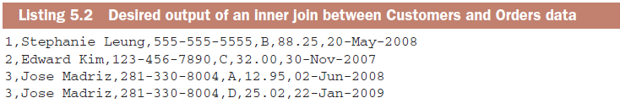
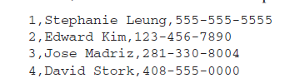
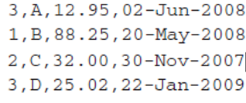
Joining data from different sources
It’s inevitable that you’ll come across data analyses where you need to pull in data from different sources.
For example, given our patent data sets, you may want to find out
if certain countries cite patents from another country. You’ll have to look at citation data (cite75_99.txt) as well as patent data for country information (apat63_99.txt). In the database world it would just be a matter of joining two tables, and most databases automagically take care of the join processing for you. Unfortunately, joining data in Hadoop

Slide 37
Reduce-side joining
In reduce-side join, we do most of the processing on the reduce side.
Reduce-side join introduces some new terminologies and concepts, namely, data source , tag , and group key . A data source is analogous to a table in relational databases.
We have two data sources in our toy example: Customers and Orders. A data source can be a single file or multiple files. The important point is that all the records in a data source have the same structure, analogous to a schema .
The MapReduce paradigm calls for processing each record one at a time in a stateless manner. If we want some state information to persist, we have to tag the record with such state.

Slide 38
Replicated joins using DistributedCache
Replicated joins using DistributedCache are simpler than reduce-side joins.
The main obstacle to performing joins in the map phase is that a record being processed by a mapper may be joined with a record not easily accessible (or even located) by that mapper.
If we can guarantee the accessibility of all the necessary data when joining a record, joining on the map side can work.
Hadoop has a mechanism called distributed cache that’s designed to distribute files to all nodes in a cluster.
It’s normally used for distributing files containing “background” data needed by all mappers.
For example, if you’re using Hadoop to classify documents , you may have a list of keywords for each class. (Or better yet, a probabilistic model for each class, but we digress…) You would use distributed cache to ensure all mappers have access to the lists of keywords, the “background” data. For executing replicated joins, we consider the smaller data source as background data.

Slide 39
Replicated joins using DistributedCache
Distributed cache is handled by the appropriately named class DistributedCache .
There are two steps to using this class.
First, when configuring a job, you call the static method DistributedCache.addCacheFile() to specify the files to be disseminated to all nodes. These files are specified as URI objects, and they default to HDFS unless a different filesystem is specified. The JobTracker will take this list of URIs and create a local copy of the files in all the TaskTrackers when it starts the job.
In the second step, your mappers on each individual TaskTracker will call the static method DistributedCache.getLocalCacheFiles() to get an array of local file Paths where the local copy is located.

Slide 40
Semijoin : reduce-side join with map-side filtering
One of the limitations in using replicated join is that one of the join tables has to be small enough to fit in memory. Even with the usual asymmetry of size in the input sources, the smaller one may still not be small enough.
You can solve this problem by rearranging the processing steps to make them more efficient.

Slide 41
Semijoin : reduce-side join with map-side filtering
Sometimes you may have a lot of data to analyze.
You can’t use replicated join no matter how you rearrange your processing steps. Don’t worry. We still have ways to make reduce-side joining more efficient.
Recall that the main problem with reduceside joining is that the mapper only tags the data, all of which is shuffled across the network but most of which is ignored in the reducer.
The inefficiency is ameliorated if the mapper has an extra prefiltering function to eliminate most or even all the unnecessary data before it is shuffled across the network. We need to build this filtering mechanism.

Slide 42
Creating a Bloom filter
If you use Hadoop for batch processing of large data sets, your data-intensive computing needs probably include transaction-style processing as well. We won’t cover all the techniques for running real-time distributed data processing (caching, sharding, etc.).
They aren’t necessarily Hadoop-related. One lesser-known tool for real-time data processing is the Bloom filter, which is a summary of a data set whose usage makes other data processing techniques more efficient.
When that data set is big, Hadoop is often called in to generate the Bloom filter representation.
As we mentioned earlier, a Bloom filter is also sometimes used for data joining within Hadoop itself. As a data processing expert, you’ll be well rewarded to have the Bloom filter in your bag of tricks.

Slide 43
What does a Bloom filter do?
The major benefit of a Bloom filter is that its size, in number of bits, is constant and is set upon initialization. Adding more elements to a Bloom filter doesn’t increase its size.
It only increases the false positive rate. A Bloom filter also has another configuration parameter to denote the number of hash functions it uses.
Bloom filter object supports two methods: add() and contains().
The method add() adds an object to the set, and the method contains() returns a Boolean true/false value denoting whether an object is in the set or not. But, for a Bloom filter, contains() doesn’t always give an accurate answer. It has no false negatives
If contains() returns false, you can be sure that the set doesn’t have the object queried. It does have a small probability of false positives though. contains() can return true for some objects not in the set.
The probability of false positives depends on the number of elements in the set and some configuration parameters of the Bloom filter itself.

Slide 44
Implementing a Bloom filter
Conceptually the implementation of a Bloom filter is quite straightforward. We describe its implementation in a single system first before implementing it using Hadoop in a distributed way.
The internal representation of a Bloom filter is a bit array of size m. We have k independent hash functions, where each hash function takes an object as input and outputs an integer between 0 and m-1.
We use the integer output as an index into the bit array. When we “add” an element to the Bloom filter, we use the hash functions to generate k indexes into the bit array. We set the k bits to 1.
When an object comes in and we want to check whether it has been previously added to the Bloom filter, we use the same k hash functions to generate the bit array indexes as we would do in adding the object. Now we check whether all those k bits in the bit array are 1s. If all k bits are 1, we return true and claim that the Bloom filter contains the object. Otherwise we return false.

Slide 45
Bloom filter in Hadoop version 0.20+.
Hadoop version 0.20 has a Bloom filter class in it. It plays a support role to some of the new classes introduced in version 0.20, and it will likely stay around for future versions as well.
It functions much like our BloomFilter class in listing 5.4, although it’s much more rigorous in its implementation of the hashing functions. As a built-in class, it can be a good choice for semijoin within Hadoop.
But it’s not easy to separate this class from the Hadoop framework to use it as a standalone class. If you’re building a Bloom filter for non-Hadoop applications, Hadoop’s built-in BloomFilter may not be appropriate.

Slide 46
Performing joins of multiple data sets
Mapreduce Join operation is used to combine two large datasets. However, this process involves writing lots of code to perform the actual join operation. Joining two datasets begins by comparing the size of each dataset. If one dataset is smaller as compared to the other dataset then smaller dataset is distributed to every data node in the cluster.
Once a join in MapReduce is distributed, either Mapper or Reducer uses the smaller dataset to perform a lookup for matching records from the large dataset and then combine those records to form output records.

Slide 47
Thank You

